Slide 1
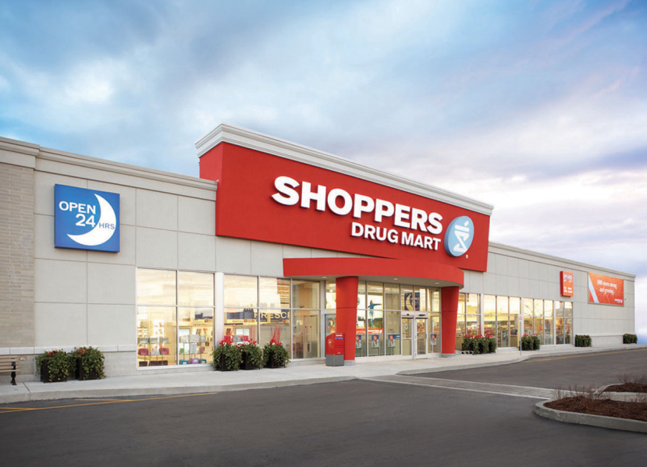

Digital Transformation in Pharmacy

Slide 2
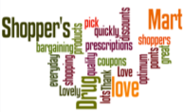
Voice of Customer – sharing experiences @SDM
Thank you shoppers for finally allowing coupons to be scanned by cell phone! Did it yesterday. Such an improvement, long overdue! Happy shopper here
I love Shopper's Drug Mart. They don’t just have my pills, have lots of everyday products, bunch of sales and promotions almost everyday, and I love racking up those optimum points!
Lovely and quality bargaining. Makes me happy inside and out!!!!!
Love shopping at Shopper's Drug Mart as it's so close to me and the staff members are always so friendly and helpful.
There is something for everyone there. The staff are always courteous and always willing to help you.
I wasn't feeling well and it was nice that I could get my prescription slip picked up, filled and delivered quickly. Have a terrific day and keep up the great service.
I like the app so much . It made shopping at shoppers and collecting points much easier than downloading coupons and looking at flyers
Top +ve
Why are stores not able to electronically check inventory at other stores? Had to go to three different locations to get imitrex today!
Let's not be advertising a bogo sale on "regular priced vitamins and supplements" and then find the ENTIRE SECTION on "sale"...Dirty:(
Terrible customer service :( not honoring coupons:( very dissatisfied
Love Shoppers but your emails are annoying.. and how about a REAL giveaway once in a while?
When are you going to get into the 21st century? You send out coupons by email and require that people PRINT them out to get the benefit. Seriously?
Your service is pretty slow. I lodged a complain few days ago and still no resolution. It has been delayed without a reason. Wasted my money and time shopping at your store.
Top
-ve
In-Store Customer Service, Coupons and Points : Make or Break relationships @Shoppers Drug Mart

Slide 3

SDM’s Everyday App vs. competition
In terms of Pharmacy features, SDM’s Everyday App has the capability to:
Rx/ Refill/ pickup reminders
Additional features:
Refill Rx via scan
Pill identifier & Reminder
Rx Transfer
Prescription history
Family Rx refills
Seasonal Notifications e.g. Flu Shots
Improving Refill reminder notifications display
Recommendations about personalized health check up schedules
Regarding Navigation and Shoppability
of the app, SDM allows shoppers to:
View Product list & info
View flyers & offers
Create Shopping List, QR scan
Additional features:
Search enabled filters
Search by voice
Add to cart
View ratings & reviews
Bluetooth / ibeacon technology to push refill and fill reminders when in vicinity of store
Connect to health devices to earn redeemable points for achieving goals – sync with wearable smartwatch
Bundling of complimentary products
Pharmacy Features
Navigation & Shoppability
In terms of Value Adds, SDM App has capability to
add a preferred pharmacy and
find nearby stores.
Additional features:
Health Dashboards
Pharmacy chat option
Insurance providers list
Event finder - Recommendations about personalized health check up schedules
DUR checks, Drug Information with recommended usage
Mail order services – for old age people and chronic diseases like diabetes
Health hazards, diet plans and Doctor Information
Evaluation of immunization history and receive a recommendation
Value Adds

Slide 4

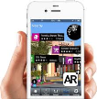

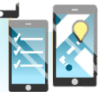
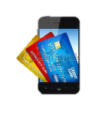

Customer journey – Re-Imagined for SDM
Your Rx is ready!
M-Wallet
At home
Store Visit
Entering the store
Inside the store
Jane gets an alert on her mobile that she is running out of meds
Weight of the pill box notifies pill level
She quickly places a refill order through her mobile app
Receives points to redeem in store;
The next day when Jane is out and about, on her holiday, she gets a message notifying that her Rx is ready for pickup.
Through the AR app on her mobile, she looks for nearest SDM store
As she enters the pharmacy, Jane is recognized in-store
Pharmacist is informed on his dashboard about Jane’s arrival.
The in-store mode of the app routes Jane to the vitamins section listed in her refill list.
As she approaches the pharmacist, he pulls up her profile on his smartphone device
He recommends the Flu-shot program for her kids – she instantly books appointment
Pharmacist suggest a new generic drug for her. She checks for drug interactions instantly on her smartphone
Jane picks up her meds, pays through m-wallet and gets her loyalty points credited
She returns home happy with the experience.
Enablers
IOT based Smart pill box
Digital SMS – Pre-Order
Refill alerts
Augmented Reality app
Personalized location based offers
iBeacon
Mobile app
Store Power
AR Promo Locator
Collect & go
In-Store App
Way finding
Scan for Info
Special item requests
Loyalty integration

Slide 5
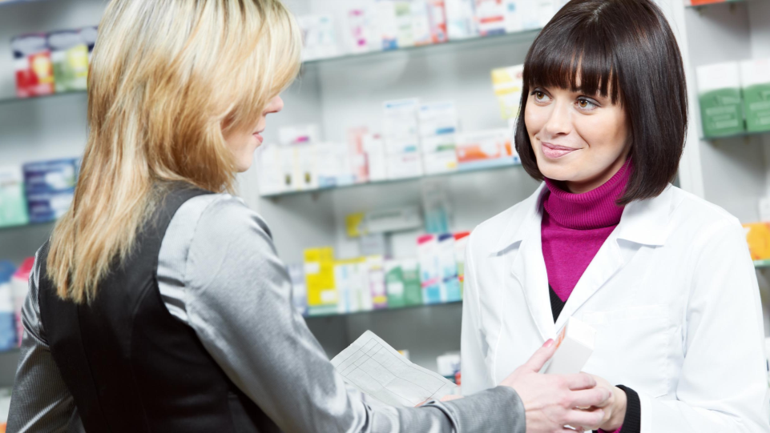
Digitally Re-imagine the Customer interactions: To Be
Give me Convenience
Keep me Healthy
Enriching Customer service
Empathize with me
IOT based Smart pill box
Digital SMS – Pre-Order
Prescription ready alerts
Family prescription management
BOPIS/ mail order
E-Transfers across stores
One click appointments scheduling
Mobile Dosage reminders
Pill identifier & Symptom tracker on mobile
Health monitoring tools
Self diagnosis application
DUR checks
In-Store Self Help – Discover, Locate Products & Promotions
Avatar: Guide me, Answer my questions
Proactive Medication review
Personalization – ‘Offers for me’, reward for my loyalty
Social Forums & communities for specific conditions
In-store event alerts, reminders

Slide 6
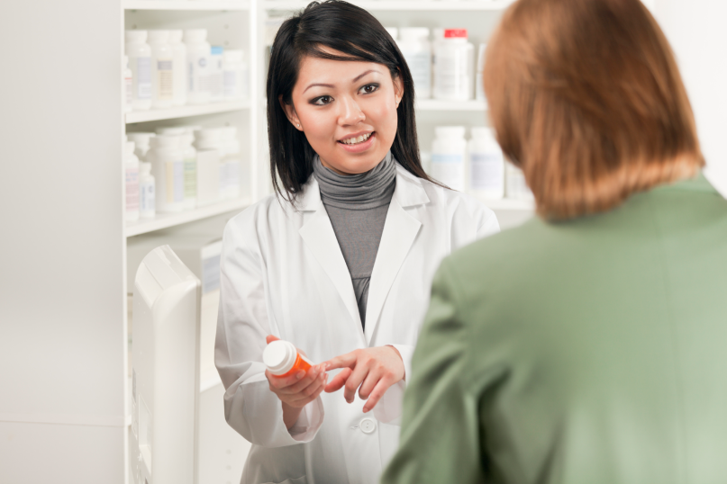
Digitally Re-imagine the Pharmacist’s interactions: To Be
Medication Therapy Management
Patient well being
Improving efficiency
Predictive alerts on diseases – flu, allergy
Prescribable digital therapies
Tracking app
Ingestible/ Wearable sensor
Smartphone enabled personal health device
Sensors for diagnosis & monitoring
Pharmacy-to-Patient Services
Analytics for patient care gaps
Perivista –
In-store customer analytics
Sentiments, Profile, Behaviour, Associations
People network & Social influence
Delivers a pre-computed set of Analytical customer metrics
Predictive alerts on Inventory
Customer Kiosks/ ipad for entering demographic info
Store Power –
task management,
predictive operations,
holistic view of customer preferences & interactions
Cross channel order visibility

Slide 7
Additional features Sample
Refill by Scan
Pill Identifier
Family Refill
SmartDevice Connect
Special Notifications

Slide 8
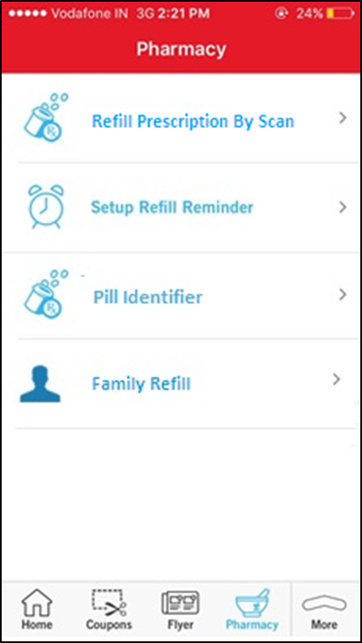
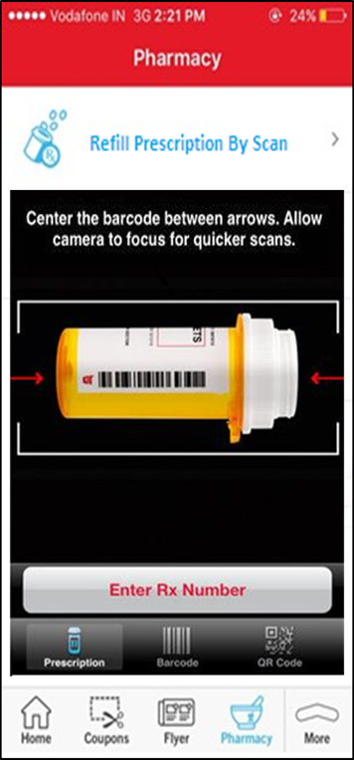
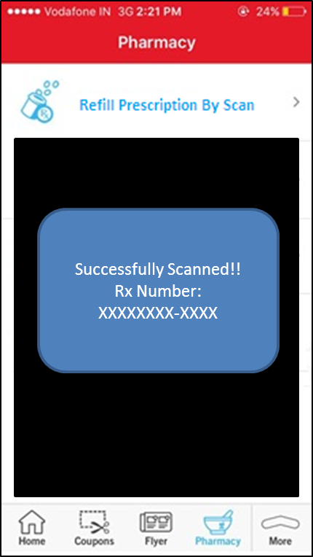
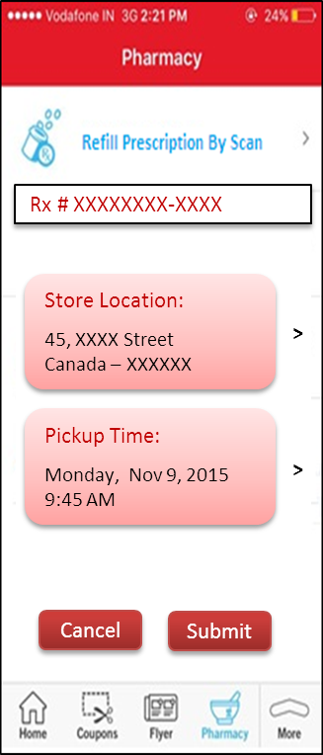
Refill By Scan

Slide 9
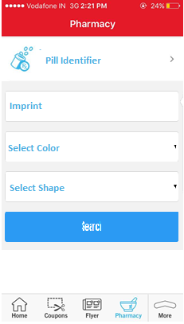
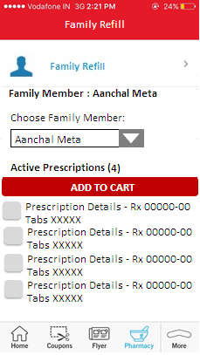
Pill Identifier & Family Refill

Slide 10
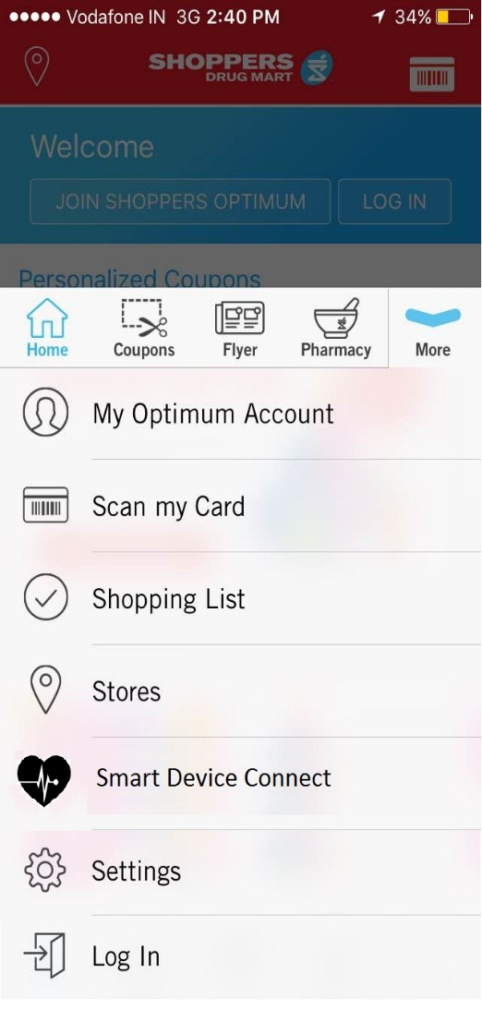
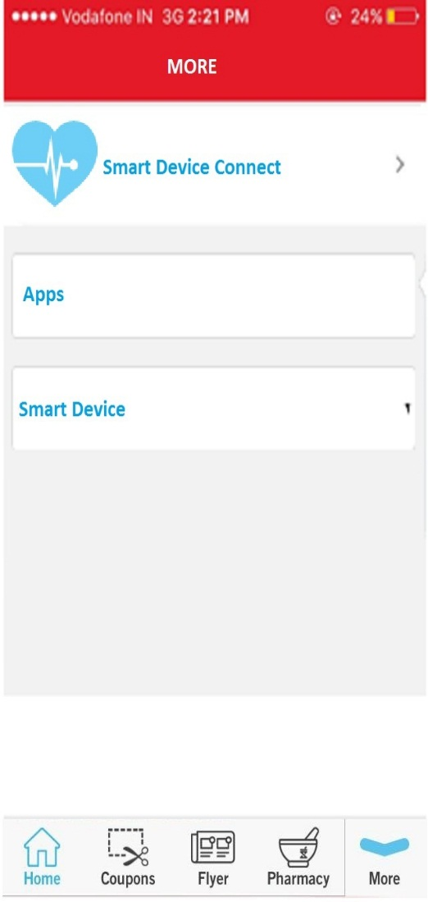
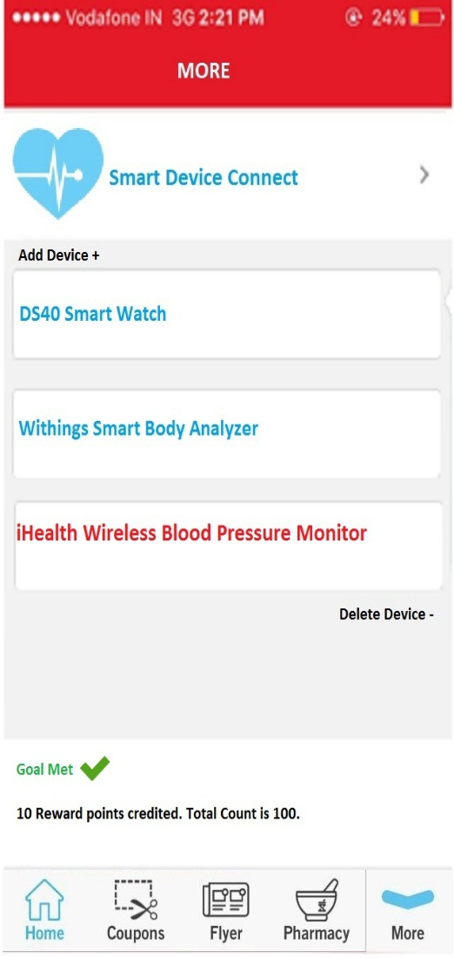
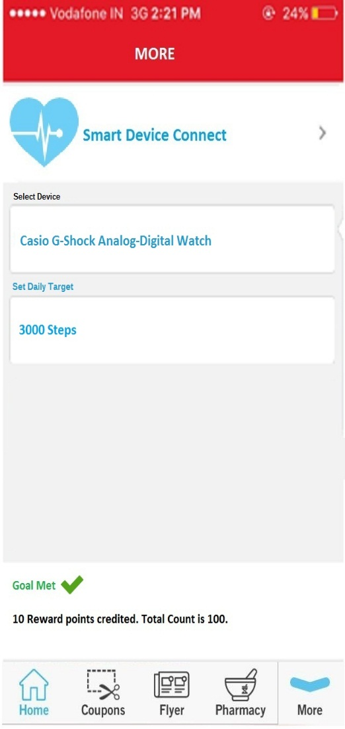
Smart Device Connect

Slide 11
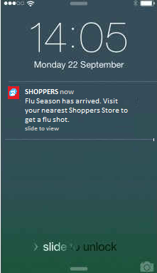
Special Notifications

